Slide 1
Introduction of Scalr
Scalr is a remote operations backend for Terraform. It executes Terraform operations and stores state, regardless of the workflow, in Scalr itself allowing for easy collaboration across your organization. That means you can easily onboard an existing GitOps or native Terraform CLI based workflows into Scalr with little to no modification to your actual code.

Slide 2
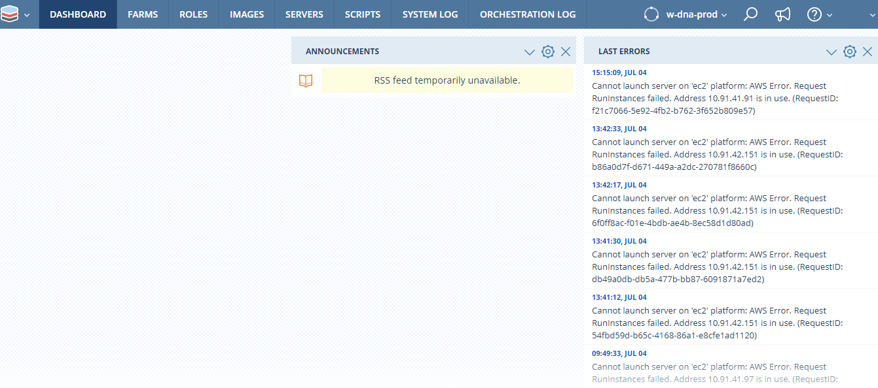
Scalr Dashboard Dashboard which is the default landing page and provides quick access to some functionality and various status information via a series of Widgets. The Widgets can be customised so that the user can choose which ones to display, their position on the Dashboard, and, in some cases, their content.

Slide 3
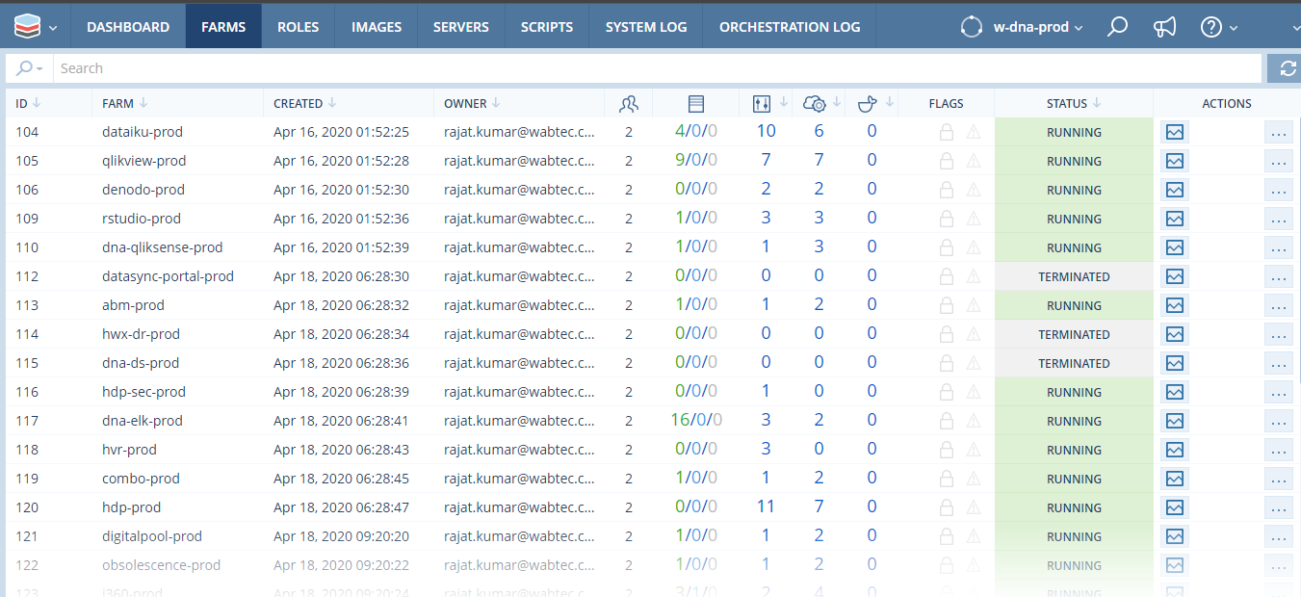
Farms A Farm is the collection of Roles, Orchestration rules, network configuration, cloud services and much more that defines the desired deployment state of a cloud-based system. A Farm can include any number of Roles that work together to provide a service, such as a basic 3-tier app that includes a load balancer, a web app layer and a database layer.

Slide 4
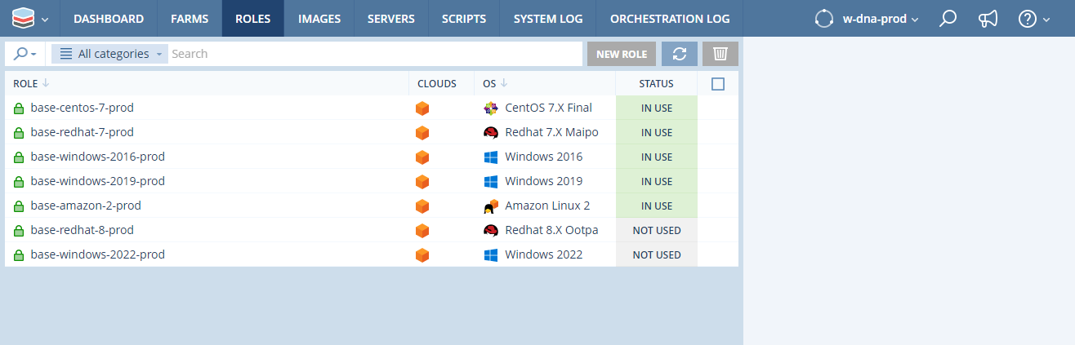
Roles It provide an abstraction layer over the top of the images. Within Scalr a Role is the reusable building block for provisioning servers through Scalr. A Role can be associated with multiple similar images from multiple clouds. All similar images linked to a role will have the same base operating system and version, and the same pre-installed software and configuration.

Slide 5
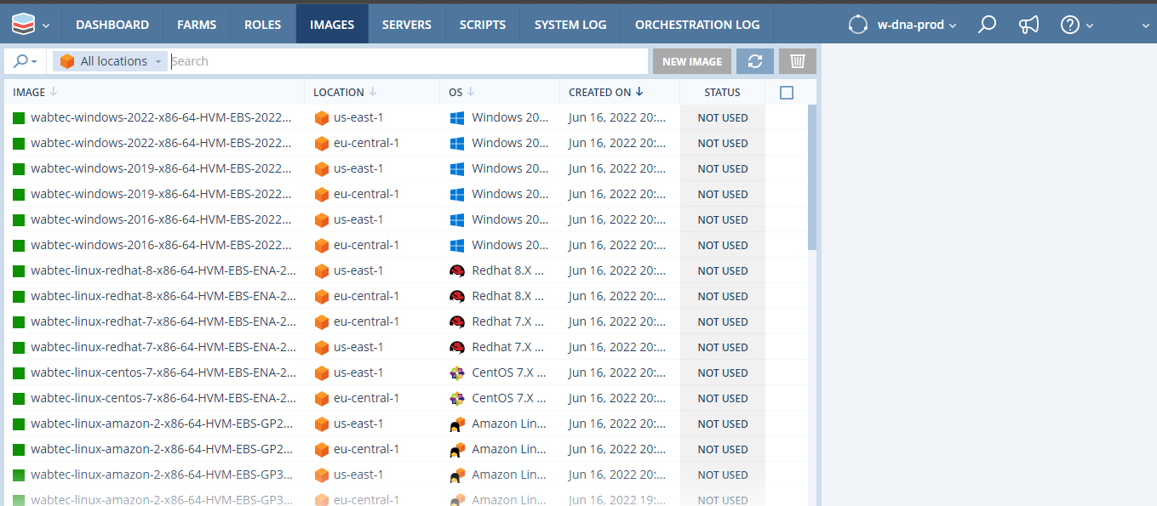
Images Images (aka, AMI, template etc) are the main building blocks for building cloud infrastructure in all clouds. Images are used to create servers in a cloud. Images users have created from customized servers with additional pre-installed software and configurations. Base and user created images can easily be imported into Scalr and converted to scalarized images through the Scalr UI.

Slide 6
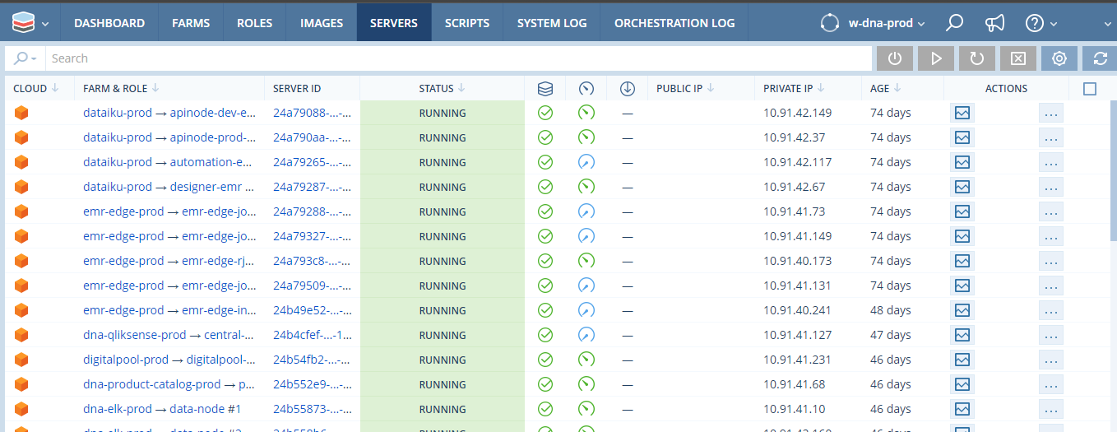
Servers A detailed server dashboard is available for each server in the server list. This provides access to detailed information about the server and some additional management actions. It provides access links to various related components such as the Farm &Role, Server ID, Public IP, Private IP, Age, Actions etc.

Slide 7
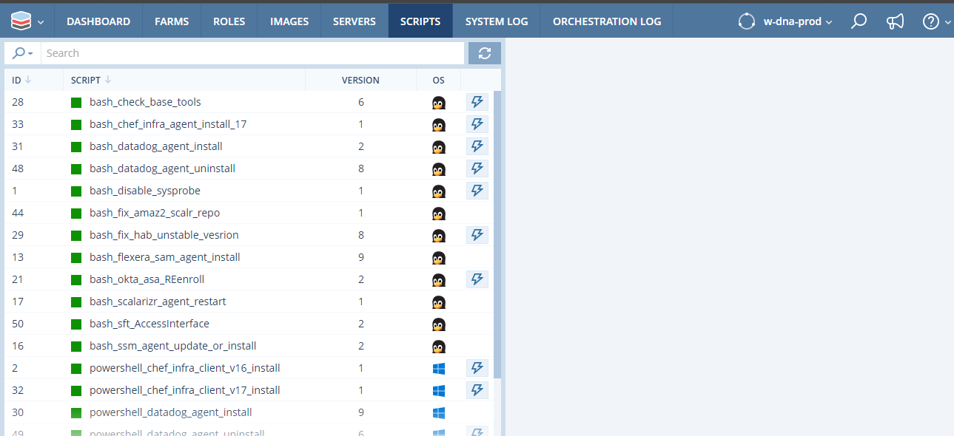
Scripts Scripts in Scalr are used in conjunction with Orchestration and can also be executed on a on-off basis if required. Scripts can perform ANY action that is valid within the context that they are run and can be written in any scripting language including shell, python, perl and Power Shell. It can be used to automate various configuration items on the operating system that Scalr is provisioning. Scripts can be defined at all scopes within Scalr.

Slide 8
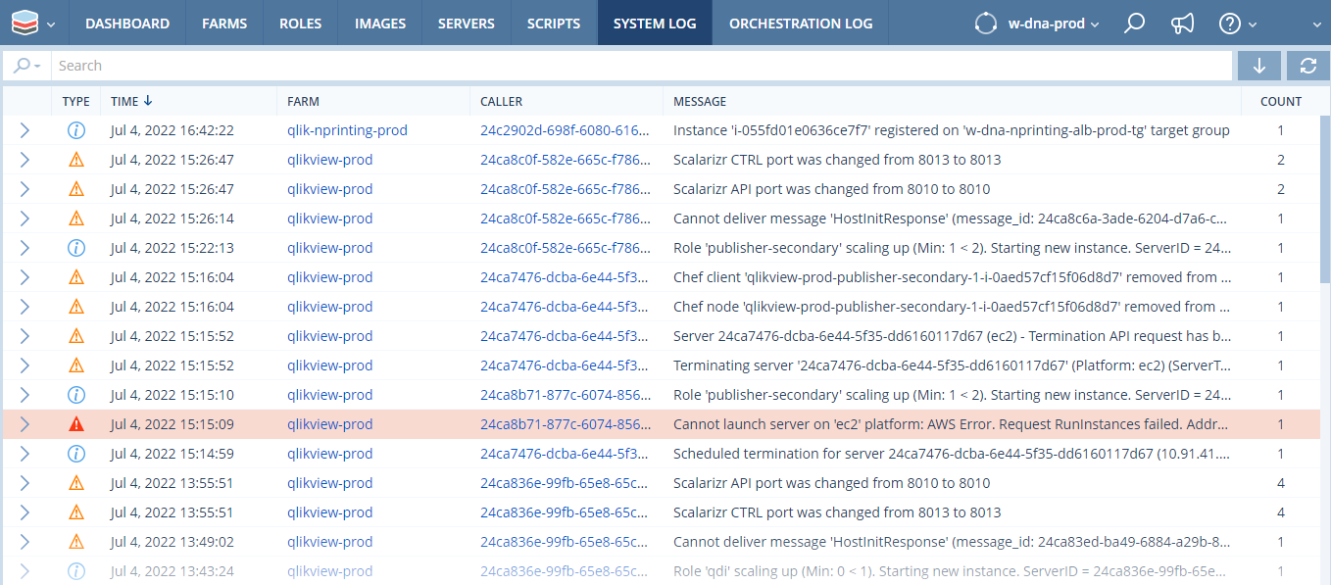
System Log System logs show the history of system notifications regarding your servers managed by Scalr. It provides access links to various related components such as: Type, Time, Farm, Caller, Message, Count.

Slide 9
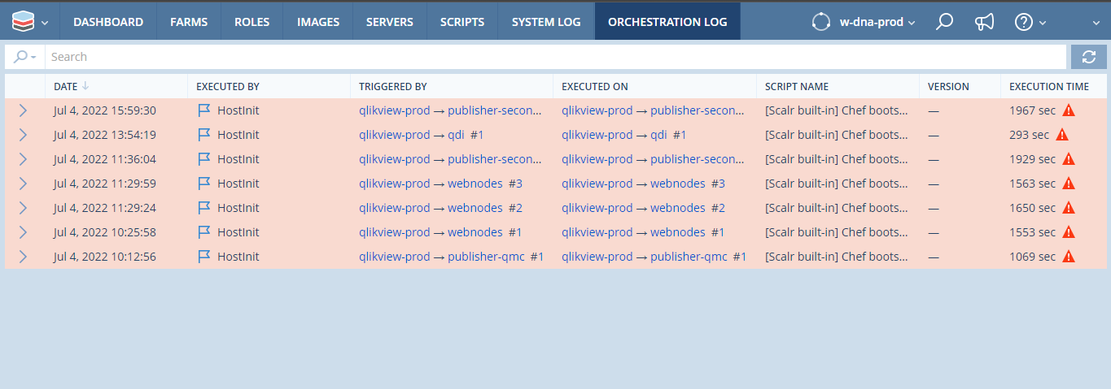
Orchestration Log Orchestration logs show the history of script execution on the servers managed by Scalr, including output and exit codes. It provides access links to various related components such as: Date, Executed By, Triggered By, Executed On, Script Name, Version, Execution Time.

